Slide 1
AP STATS
Iman Mossavat

Slide 2
Agenda
Introduction
Probabilities
Bayes' Rule
Graphical Models
Simpson's Paradox

Slide 3
Probabilities

Slide 4
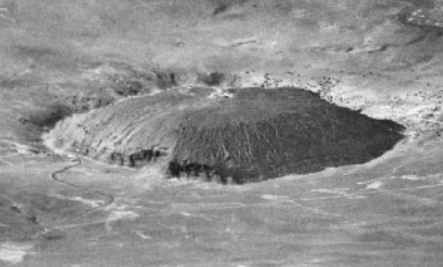
Is this a hill or a crater?
Seeing is not a direct apprehension of reality, as we often like to pretend. Quite the contrary: seeing is inference from incomplete information ... ET Jaynes, 2003

Slide 5
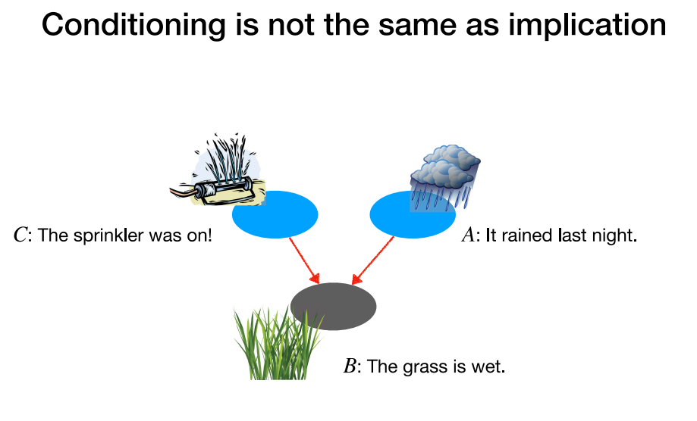
The Sprinkler and Rain are Causally independent. But observing that the grass is wet makes them statistically dependent.

Slide 6
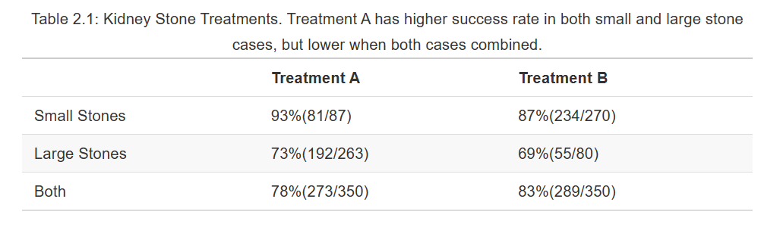
Simpson's Paradox
>
>
<
Chapter 2 Correlation and Simpson’s Paradox | Causal Inference and Its Applications in Online Industry (alexdeng.github.io)

Slide 7
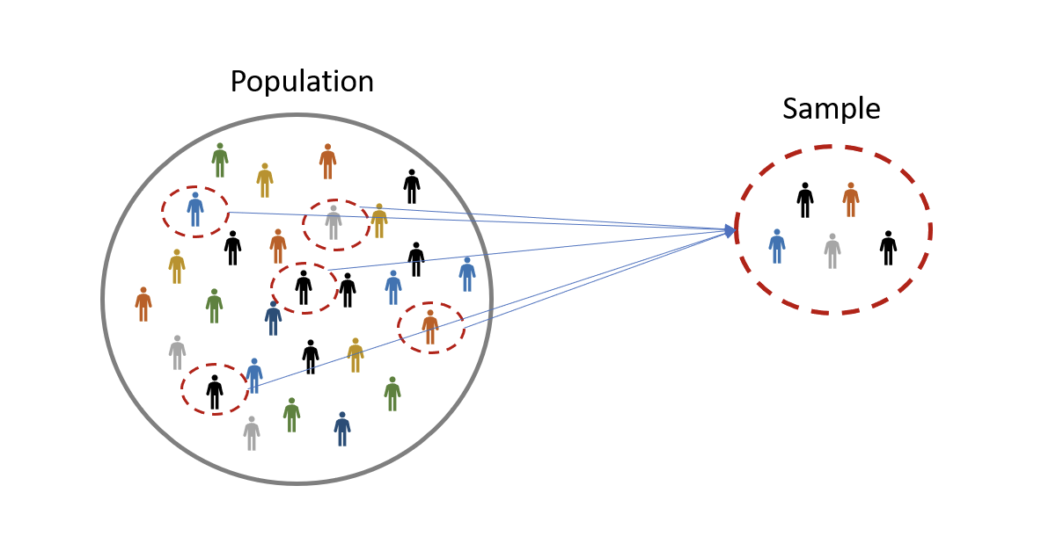
Population vs Sample

Slide 8
From Data to Decisions: How Do We Reason Under Uncertainty?
A medical test is positive. How likely is it that the patient actually has the disease?
  1% of the population has the disease.
  The test detects the disease 95% of the time.
  The test is positive for 5% of healthy people.

Slide 9
Probabilities are explained in three different levels of abstraction:
  Frequency tables (counts and proportions)
  Ven diagrams (set theory)
  The most abstract way: the three rules of probability

Slide 10
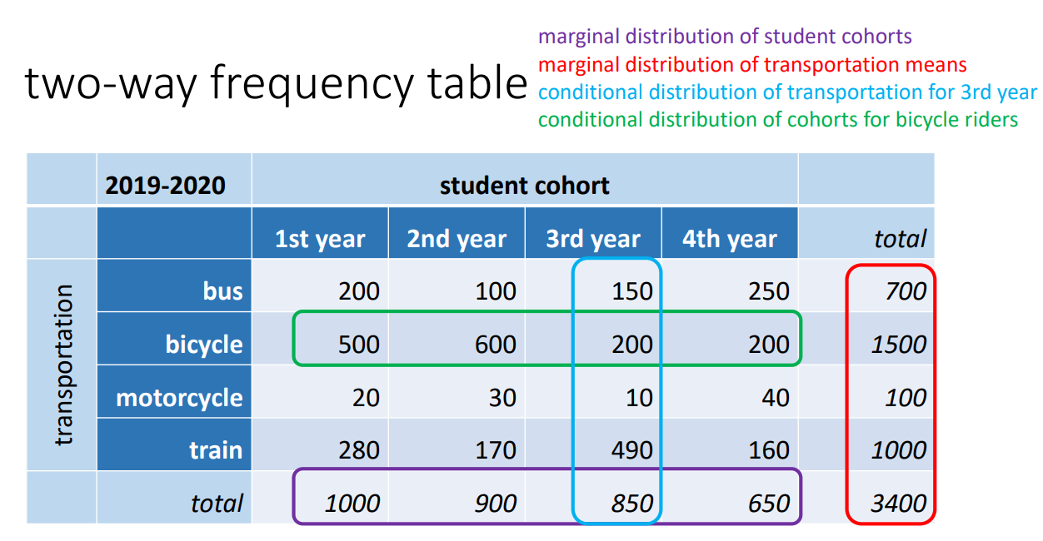

Slide 11
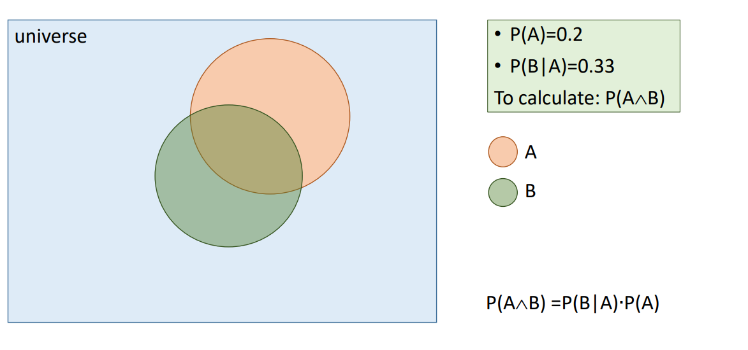

Slide 12



Probabilities (Normalization)
$$P\left(blue\right)=\frac{3}{5}$$
$$P\left(orange\right)=\frac{2}{5}$$
$$P\left(blue\right)+\left(orange\right)=1$$

Slide 13



Probabilities (Marginalization)
$$P\left(star\right)=\frac{2}{5}$$
$$P\left(orange,star\right)=\frac{1}{5}$$
$$P\left(blue,star\right)=\frac{1}{5}$$
$$P\left(star\right)=P\left(orange,star\right)+P\left(blue,star\right)$$
Here we do not care about the color, so we marginalize it out and the get the probabilities of the shape.

Slide 14


Conditional Probabilities
$$P\left(blue\right)=\frac{3}{5}$$
$$P\left(star|blue\right)=\frac{1}{3}$$
$$P\left(blue,star\right)=\frac{1}{5}$$
$$P\left(blue,star\right)=P\left(blue\right)×P(start|blue)$$

Slide 15

Conditional Probabilities
$$P\left(star\right)=\frac{2}{5}$$
$$P\left(blue|star\right)=\frac{1}{2}$$
$$P\left(blue,star\right)=\frac{1}{5}$$
$$P\left(blue,star\right)=P\left(blue\right)×P(start|blue)$$

Slide 16

Probabilities
$\sum_{x}{P(X=x)}=1$ (Normalization)
$\sum_{x}{P\left(X=x,Y=y\right)}=P(Y=y)$ (Marginalization)
$P\left(X=x,Y=y\right)=P\left(X=x | Y=y \right)P(Y=y)$ (Conditioning)
Section 1.2 of Chapter 1 of PRML book: microsoft.com/en-us/research/uploads/prod/2006/01/Bishop-Pattern-Recognition-and-Machine-Learning-2006.pdf
The first chapter of this book PP16 to 25. (more philosophical) : aprsa.villanova.edu/files/sivia.pdf
Notes:
Section 1.2 of Chapter 1 of PRML book: Pattern Recognition and Machine Learning (microsoft.com) Links to an external site.
The first chapter of this book PP16 to 25. (more philosophical) : sivia.pdf (villanova.edu)Links to an external site.

Slide 17
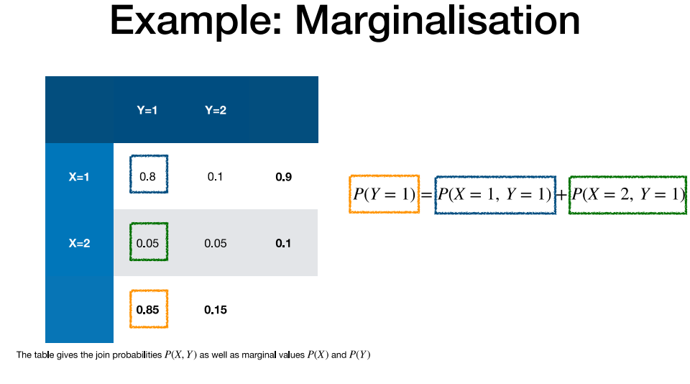

Slide 18
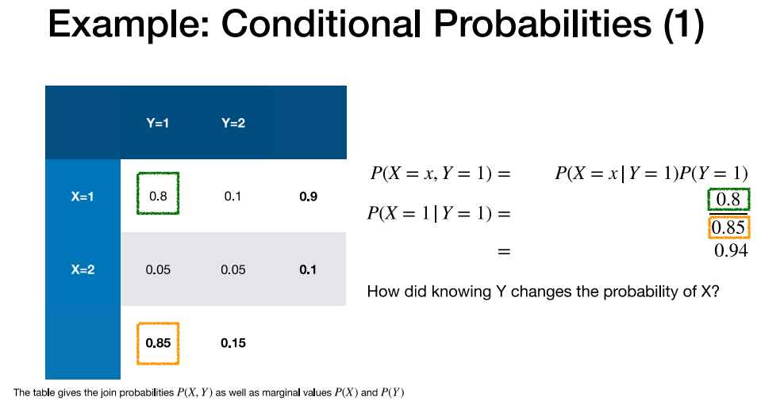
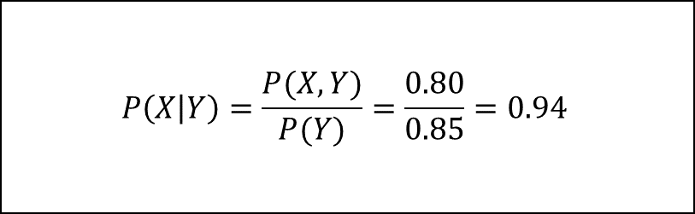
$$P\left(X | Y\right)=\frac{P(X,Y)}{P(Y)}=\frac{0.80}{0.85}=0.94$$

Slide 19
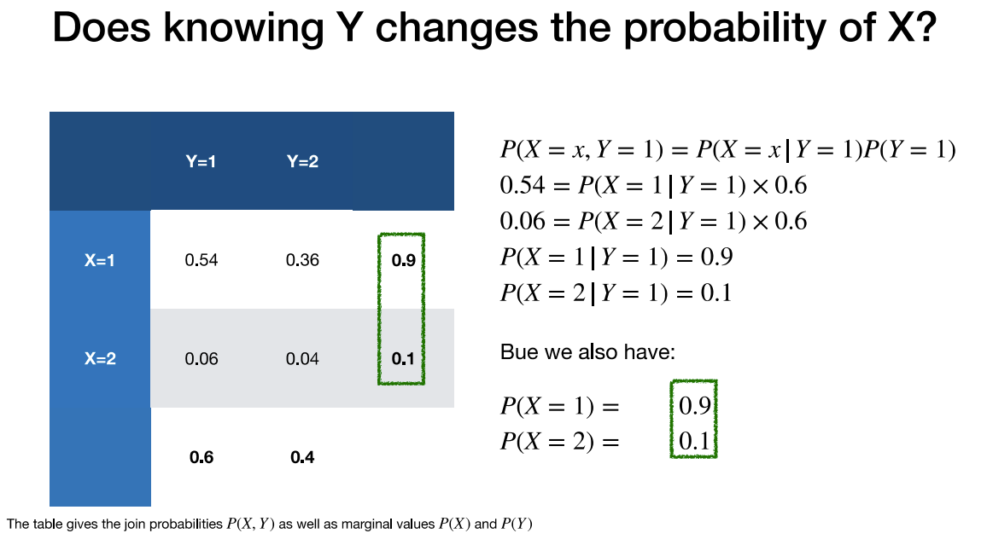

Slide 23
No!

Slide 24
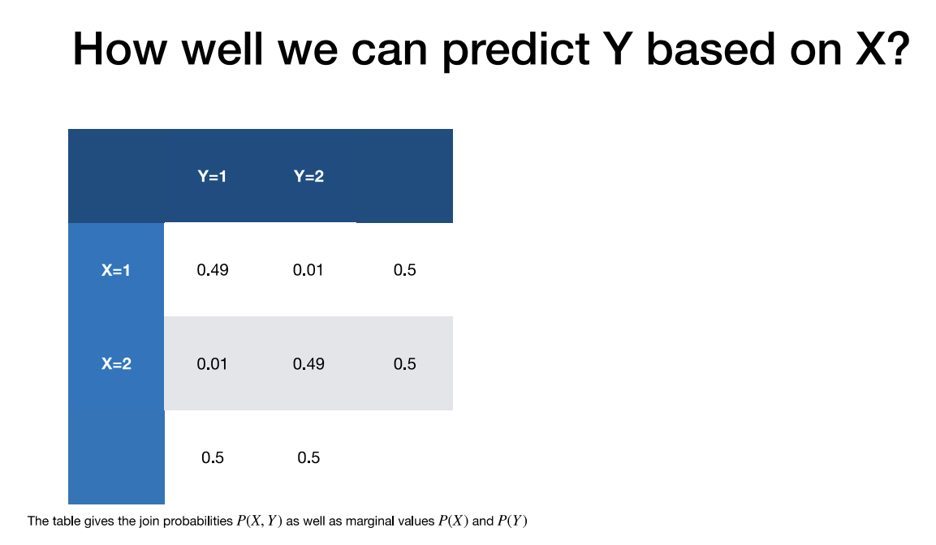

Here while X is as random as it can get (50-50 chance), knowing Y gives a lot of information about X.
Check that by comparing numerical values of $P\left(X=x | Y=y \right)$ and $P\left(X=x\right)$ for different choices of $x$ and $y$.

Slide 25


What does $P\left(X=x | Y=y \right)$ represent?
$P\left(X=x | Y=y \right)$ represents how knowledge of Y impacts our knowledge about X.

Slide 26
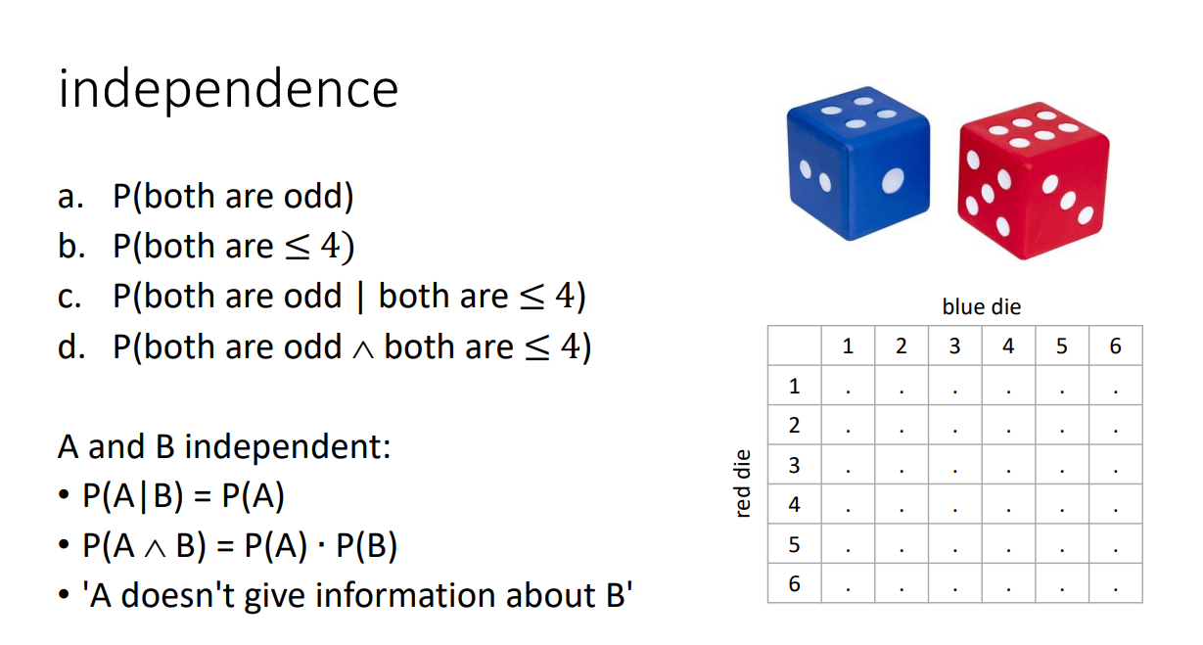

Slide 27
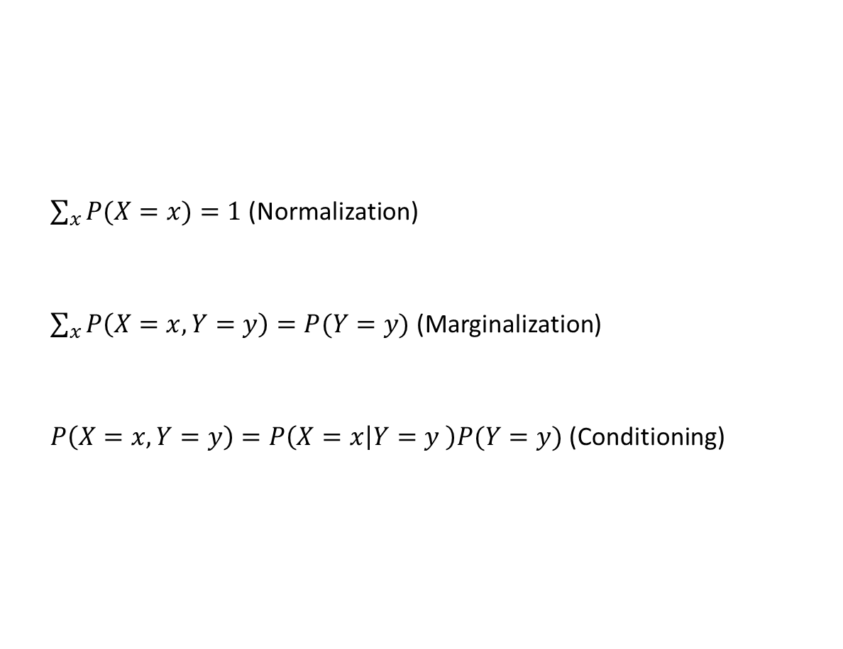
Probabilities
$\sum_{x}{P(X=x)}=1$ (Normalization)
$\sum_{x}{P\left(X=x,Y=y\right)}=P(Y=y)$ (Marginalization)
$P\left(X=x,Y=y\right)=P\left(X=x | Y=y \right)P(Y=y)$ (Conditioning)

Slide 28
Bayes' Rule

Slide 29
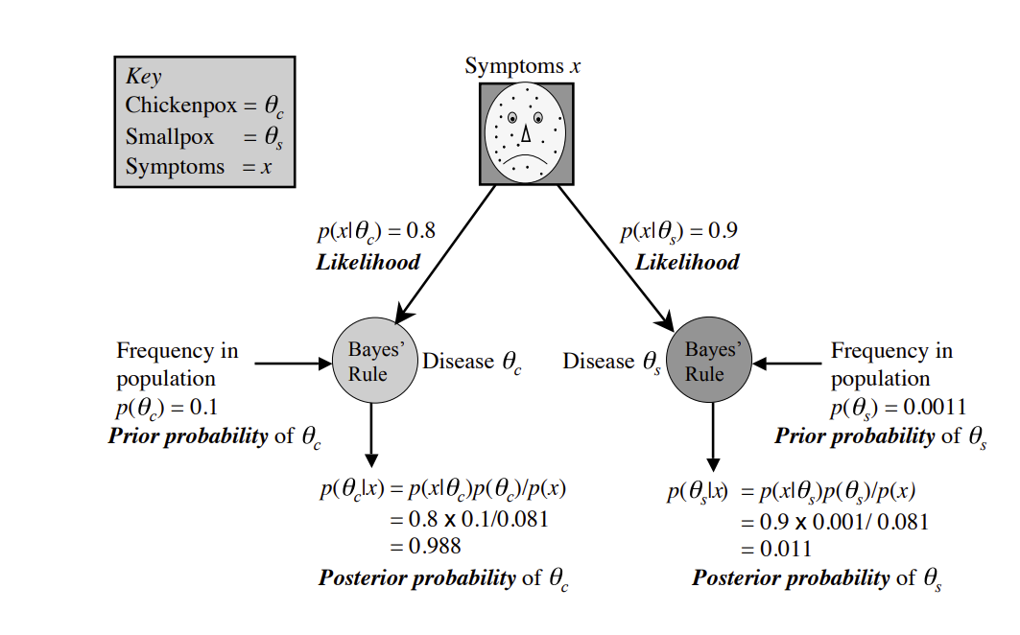
(PDF) Bayes' Rule: A Tutorial Introduction to Bayesian Analysis (researchgate.net)
What is causing the symptoms?
Notes:
(PDF) Bayes' Rule: A Tutorial Introduction to Bayesian Analysis (researchgate.net)Links to an external site.

Slide 30

What is causing the symptoms?
$$P\left(θ | x\right)$$

Slide 31

What is causing the symptoms?
$$P\left(θ | x\right)=\frac{P(θ,x)}{P\left(x\right)}$$

Slide 32

What is causing the symptoms?
$$P\left(θ | x\right)=\frac{P\left(x | θ\right)P\left(θ\right)}{P\left(x\right)}$$

Slide 33

Prevalence of the symptoms in the overall population
$$P\left(x\right)=0.081$$

Slide 35
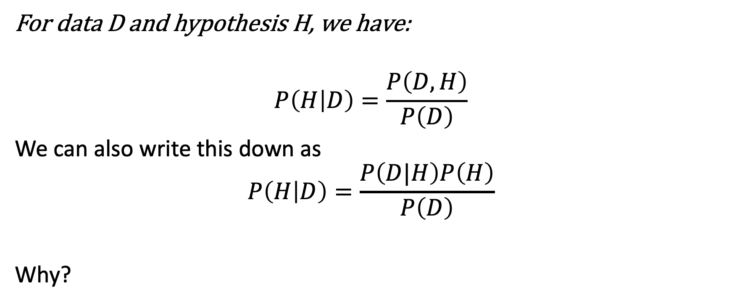
Bayes rule
For data D and hypothesis H, we have:
$$P\left(H | D\right)=\frac{P\left(D,H\right)}{P\left(D\right)}$$
We can also write this down as
$$P\left(H | D\right)=\frac{P\left(D|H\right)P\left(H\right)}{P\left(D\right)}$$
Why?

Slide 36
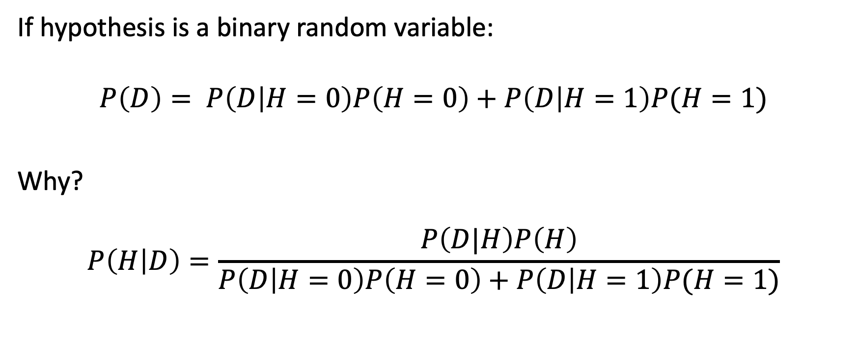
Bayes rule for Binary random variables
If hypothesis is a binary random variable:
$$P\left(D\right)= P\left(D | H=0\right)P\left(H=0\right)+P\left(D | H=1\right)P(H=1)$$
Why?
$$P\left(H | D\right)=\frac{P\left(D|H\right)P\left(H\right)}{P\left(D | H=0\right)P\left(H=0\right)+P\left(D | H=1\right)P(H=1)}$$

Slide 37
Example: Medical Tests
Suppose a rare disease affects only 1% of the population. A diagnostic test is highly accurate.
  If someone does not have the disease, the probability of receiving a false positive is only 5%. (false positive means the test result is positive for a healthy person).
  If someone is infected, the probability of receiving a false negative is 0. (false negative means the test is negative for an unhealthy person)

Slide 38
Example: Medical Tests
It is tempting to interpret a positive result as meaning there is only a 5% chance that the person is healthy. But that is not what the 5% means.
But Bayes rule will give us a very different answer.

Slide 39

Probability of being sick (hypothesis) given the positive test result (data)
$$P\left(H=1 | D=+\right)=\frac{P\left(D=+|H=1\right)P\left(H=1\right)}{P\left(D=+ | H=0\right)P\left(H=0\right)+P\left(D=+ | H=1\right)P(H=1)}$$

Slide 40

Step 1, find the required quantities
Suppose a rare disease affects only 1% of the population. A diagnostic test is highly accurate.
  If someone does not have the disease, the probability of receiving a false positive is only 5%.
  If someone is infected, the probability of receiving a false negative is 0.
$$P\left(H=1\right)$$
$$P\left(H=0\right)$$
$$P\left(D=+|H=0\right)$$
$$P\left(D=+|H=1\right)$$

Slide 41
A Forensic DNA Match
Now consider a city of 500,000 people where a DNA sample from a crime scene is compared with a suspect. The suspect was found by randomly testing someone from the population and their DNA was matched.
Suppose the genetic test has a 99% sensitivity and a 0.01% false-positive rate:
What is the chance that the person is guilty?

Slide 42

Step 1, find the required quantities
$$P\left(T=+|H=1\right) \\ P\left(T=+|H=0\right)$$
$$P\left(H=1\right)$$
$$P\left(H=0\right)$$

Slide 43
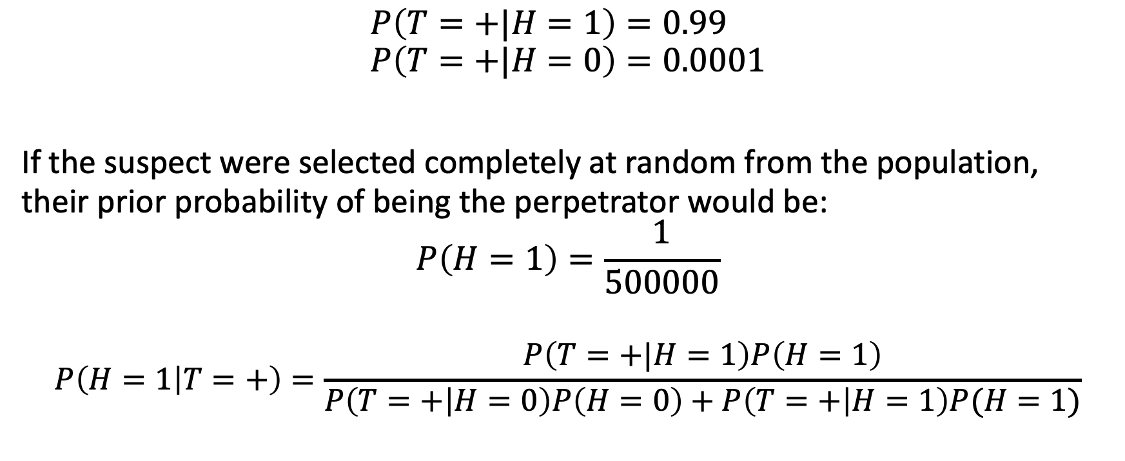
$$P\left(T=+|H=1\right)=0.99 \\ P\left(T=+|H=0\right)=0.0001$$
If the suspect were selected completely at random from the population, their prior probability of being the perpetrator would be:
$$P\left(H=1\right)=\frac{1}{500000}$$
$$P\left(H=1 | T=+\right)=\frac{P\left(T=+|H=1\right)P\left(H=1\right)}{P\left(T=+ | H=0\right)P\left(H=0\right)+P\left(T=+ | H=1\right)P(H=1)}$$

Slide 44
A Radical Scientific Theory
Suppose a new measurement shows that a particle is moving faster than the speed of light.
Suppose our measurement is highly accurate: if the particle is actually moving faster than light, the experiment will detect it with a probability of 99%.
However, because of measurement noise, even if the particle is moving slower than the speed of light, the experiment may still indicate that it is moving faster than light (a false positive) with a probability of 0.0000003.
Given that the measurement is positive, what is the probability that the particle is actually moving faster than light?
Notes:
OPERA neutrino anomaly of 2011 – Numbers are assumed.

Slide 45
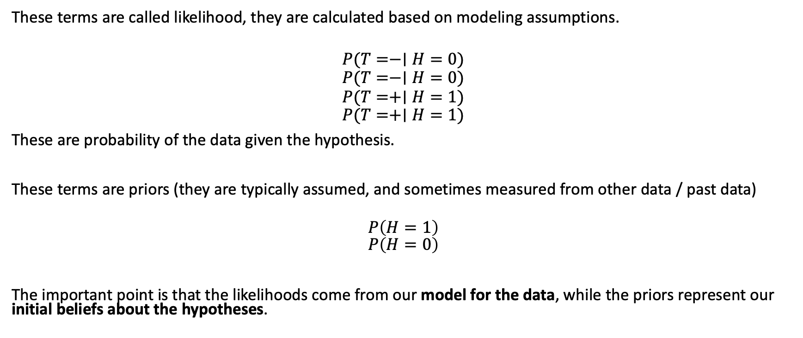
But how do you get these probabilities?
These terms are called likelihood, they are calculated based on modeling assumptions.
$$P(T=−∣H=0)$$
$$P(T=−∣H=0)$$
$$P(T=+∣H=1)$$
$$P(T=+∣H=1)$$
These are probability of the data given the hypothesis.
These terms are priors (they are typically assumed, and sometimes measured from other data / past data)
$$P\left(H=1\right)$$
$$P\left(H=0\right)$$
The important point is that the likelihoods come from our model for the data, while the priors represent our initial beliefs about the hypotheses.

Slide 46
Is this a hill or a crater?
Seeing is not a direct apprehension of reality, as we often like to pretend. Quite the contrary: seeing is inference from incomplete information ... ET Jaynes, 2003

Slide 47
Videos worthy to watch
Binomial distributions | Probabilities of probabilities: https://youtu.be/8idr1WZ1A7Q
Bayes theorem, the geometry of changing beliefs: https://youtu.be/HZGCoVF3YvM

Slide 48
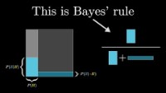
https://youtu.be/HZGCoVF3YvM?si=8RoY7hWDC-7NoqUa

Slide 49
Graphical Models

Slide 50
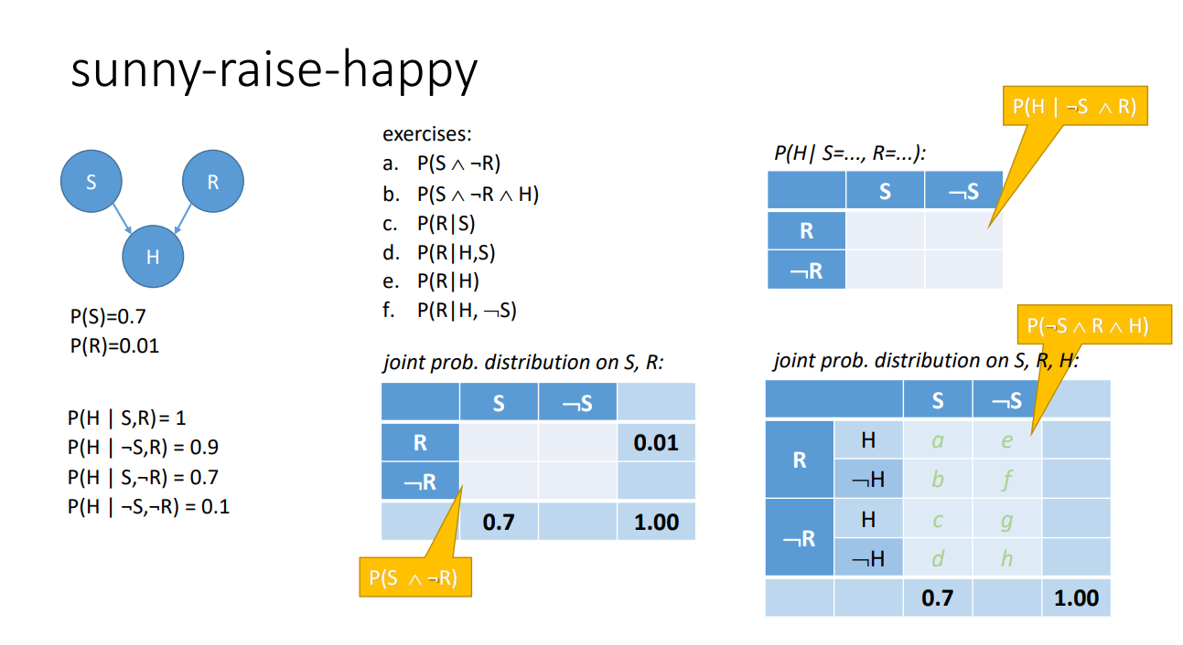
Fill in the table given the model

Slide 52
1*0.7*0.01 | 0.9*0.01*0.3
0 | 0.1*0.3*0.01
0.7*0.7*0.99 | 0.1*0.3*0.99
0.3*0.7*0.99 | 0.9*0.3*0.99
Notes:
Explain that $\sum_{x}{P\left(X=x | C=c\right)}=1$ but $\sum_{c}{P\left(X=x | C=c\right)}$ is an arbitrary number.
Explain $P\left(H | S,R\right)+P\left(¬H | S,R\right)=1$
Notation not good, should be changed in this slide. $P\left(H=1 | S=1,R=1\right)+P\left(H=0 | S=1,R=1\right)=1$
Add this model right in the beginning of explaining probabilities.
Some slide on BP

Slide 53
1*0.7*0.01 | 0.9*0.01*0.3
0 | 0.1*0.3*0.01
0.7*0.7*0.99 | 0.1*0.3*0.99
0.3*0.7*0.99 | 0.9*0.3*0.99
Notes:
Explain that $\sum_{x}{P\left(X=x | C=c\right)}=1$ but $\sum_{c}{P\left(X=x | C=c\right)}$ is an arbitrary number.
Explain $P\left(H | S,R\right)+P\left(¬H | S,R\right)=1$
Notation not good, should be changed in this slide. $P\left(H=1 | S=1,R=1\right)+P\left(H=0 | S=1,R=1\right)=1$
Add this model right in the beginning of explaining probabilities.
Some slide on BP

Slide 54
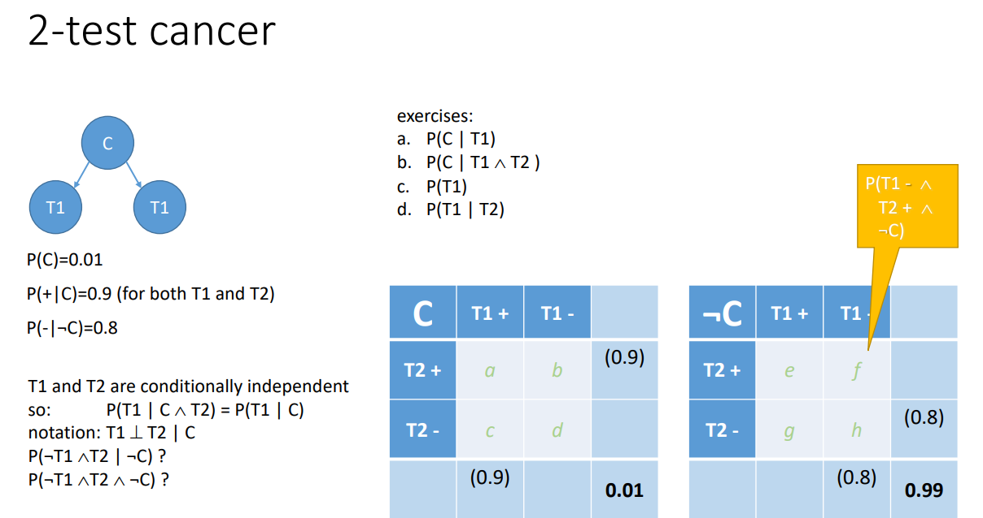

Slide 57
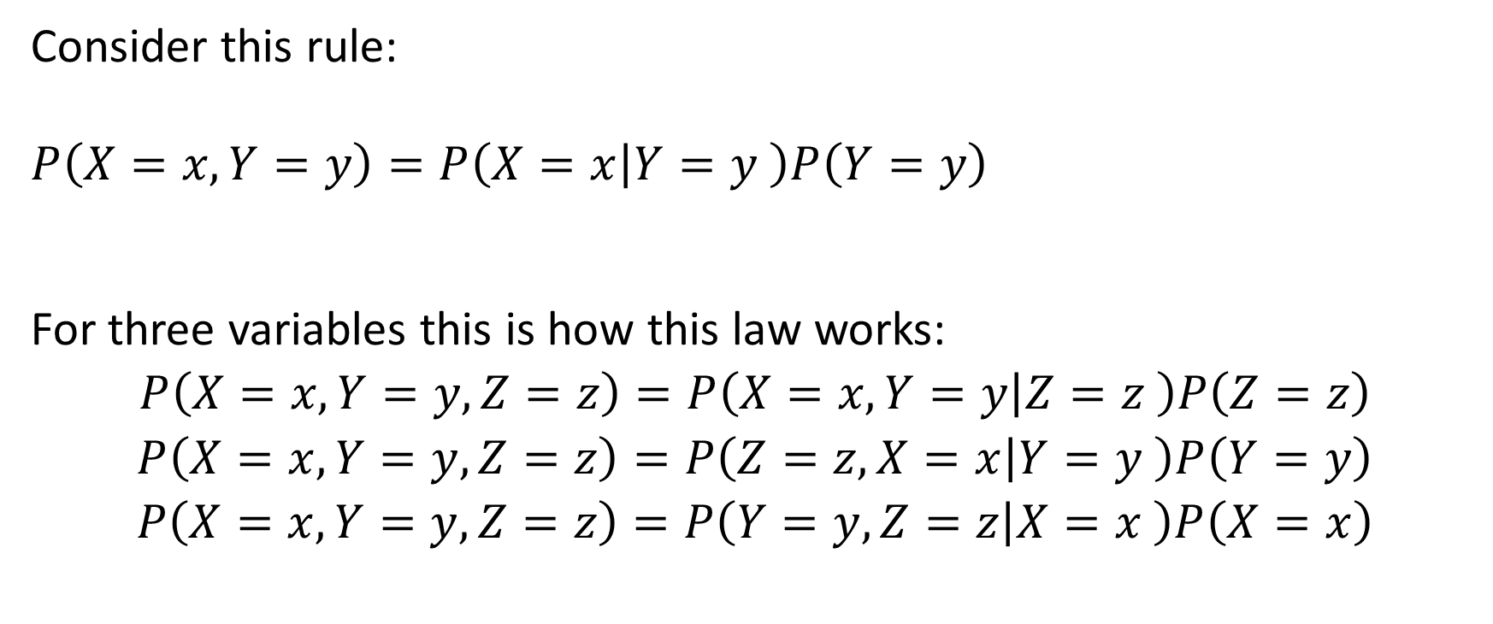
More than 2 random variables
Consider this rule:
$$P\left(X=x,Y=y\right)=P\left(X=x | Y=y \right)P\left(Y=y\right)$$
For three variables this is how this law works:
$$P\left(X=x,Y=y,Z=z\right)=P\left(X=x,Y=y | Z=z \right)P\left(Z=z\right)$$
$$P\left(X=x,Y=y,Z=z\right)=P\left(Z=z,X=x | Y=y \right)P\left(Y=y\right)$$
$$P\left(X=x,Y=y,Z=z\right)=P\left(Y=y,Z=z | X=x \right)P\left(X=x\right)$$

Slide 58
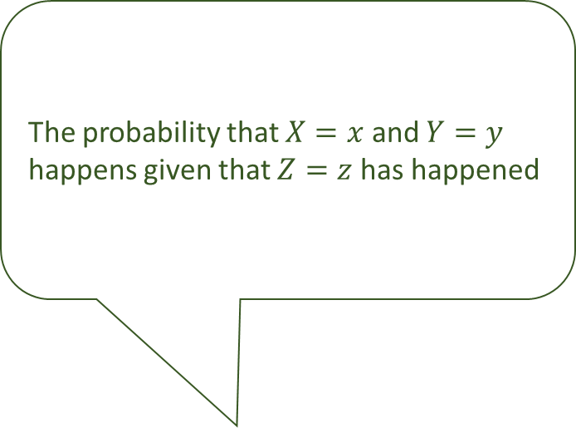

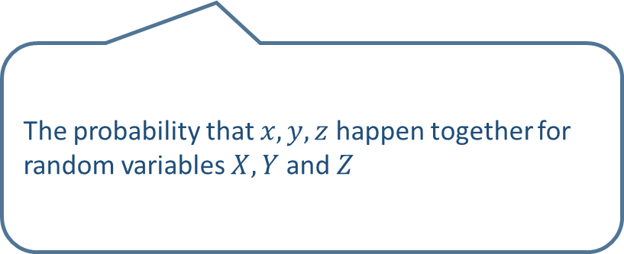
Interpretation
The probability that $X=x$ and $Y=y$ happens given that $Z=z$ has happened
$$P\left(X=x,Y=y,Z=z\right)=P\left(X=x,Y=y | Z=z \right)P\left(Z=z\right)$$
The probability that $x,y, z$ happen together for random variables $X,Y$ and $Z$
The probability that $Z=z$ happens
$$P\left(Z=z\right)$$

Slide 59
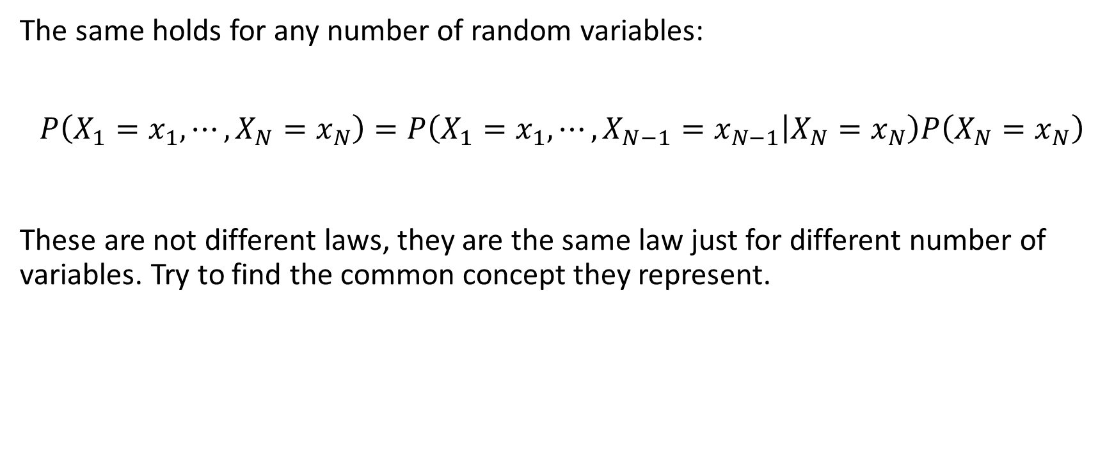
More than 3 variables
The same holds for any number of random variables:
$$P\left(X_{1}=x_{1},⋯,X_{N}=x_{N}\right)=P\left(X_{1}=x_{1},⋯,X_{N−1}=x_{N−1} | X_{N}=x_{N}\right)P\left(X_{N}=x_{N}\right)$$
These are not different laws, they are the same law just for different number of variables. Try to find the common concept they represent.

Slide 60
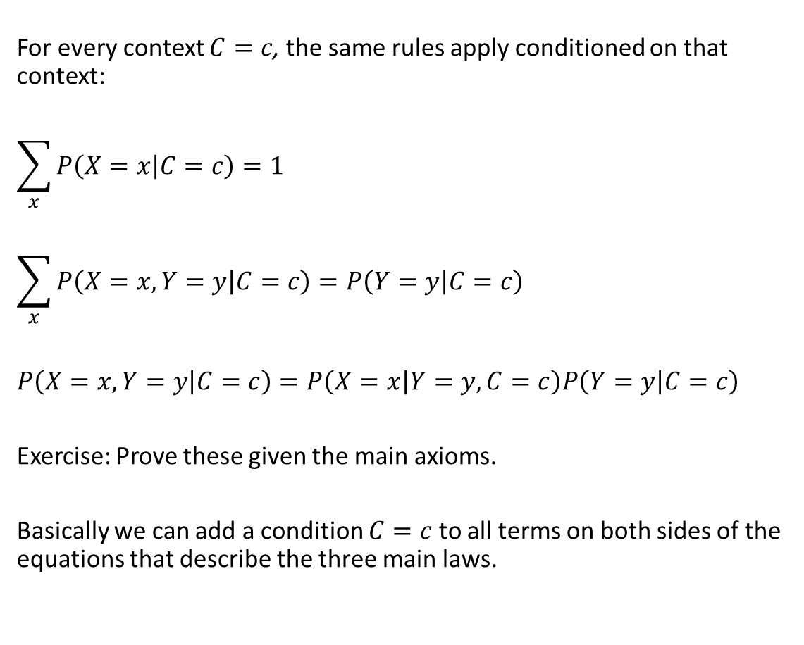
Probabilities and context
For every context $C=c$, the same rules apply conditioned on that context:
$$\sum_{x}{P\left(X=x | C=c\right)}=1$$
$$\sum_{x}{P\left(X=x,Y=y | C=c\right)}=P\left(Y=y | C=c\right)$$
$$P\left(X=x,Y=y | C=c\right)=P\left(X=x | Y=y, C=c\right)P\left(Y=y | C=c\right)$$
Exercise: Prove these given the main axioms.
Basically we can add a condition $C=c$ to all terms on both sides of the equations that describe the three main laws.

Slide 61
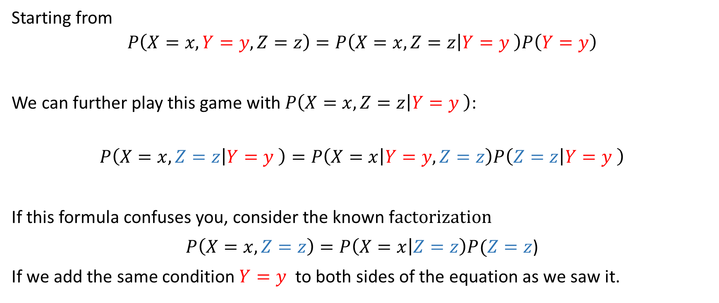
Creating a chain (1/2)
Starting from
$$P\left(X=x,Y=y,Z=z\right)=P\left(X=x,Z=z | Y=y \right)P\left(Y=y\right)$$
We can further play this game with $P\left(X=x,Z=z | Y=y \right)$:
$$P\left(X=x,Z=z | Y=y \right)=P\left(X=x | Y=y,Z=z\right)P\left(Z=z | Y=y \right)$$
If this formula confuses you, consider the known f
)
If we add the same condition $Y=y$ to both sides of the equation as we saw it.

Slide 62
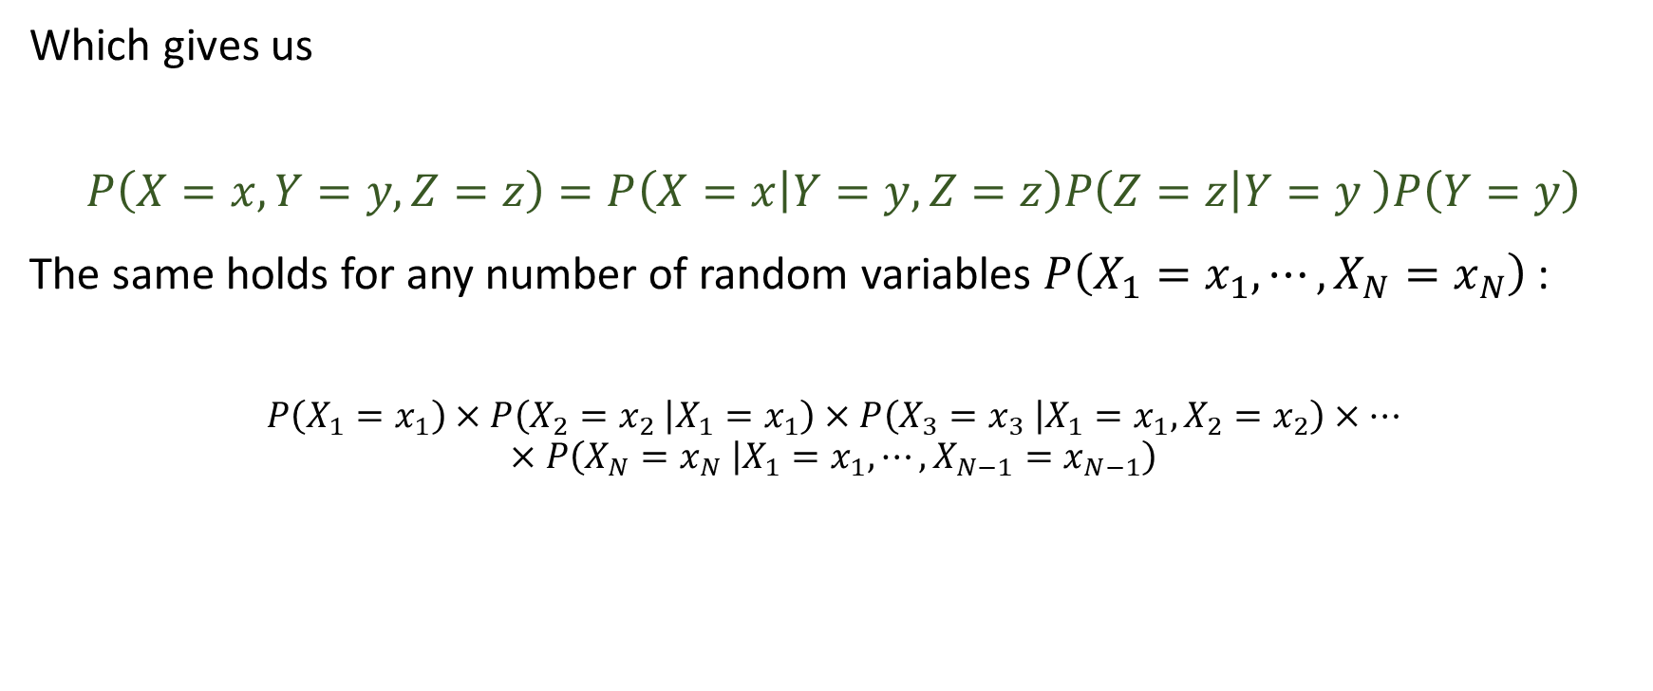
Creating a chain (2/2)
Which gives us
$$P\left(X=x,Y=y,Z=z\right)=P\left(X=x | Y=y,Z=z\right)P\left(Z=z | Y=y \right)P\left(Y=y\right)$$
The same holds for any number of random variables $P\left(X_{1}=x_{1},⋯,X_{N}=x_{N}\right)$:
$$P\left(X_{1}=x_{1}\right)×P\left(X_{2}=x_{2} | X_{1}=x_{1}\right)×P\left(X_{3}=x_{3} | X_{1}=x_{1},X_{2}=x_{2}\right)×⋯×P\left(X_{N}=x_{N} | X_{1}=x_{1},⋯,X_{N−1}=x_{N−1}\right)$$

Slide 63
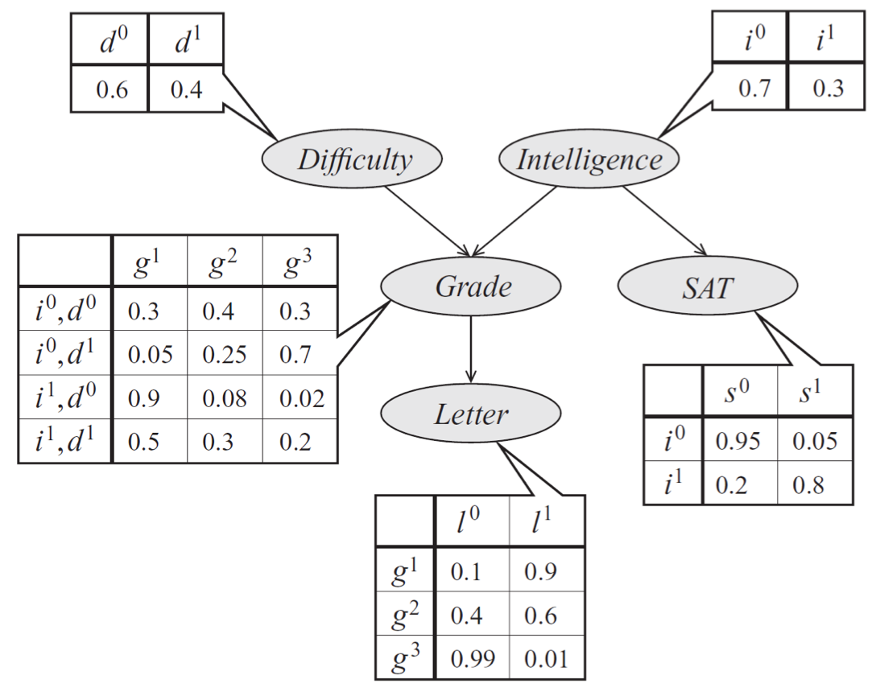
Efficient representation of joint probabilities (1/5)
Every table represents (conditional) probabilities:
  For Difficulty and Intelligence random variables note the two numbers sum up to one.
  Grade depends on difficulty and Intelligence
  SAT exam results depend on intelligence
  Getting a recommendation letter depends on the grade.
  Note the sum of all numbers in each row sum up to one. Why?
  Note the graph has no loops, it is directed and acyclic.
See more explanations next slide
Bayesian networks (ermongroup.github.io)

Slide 64
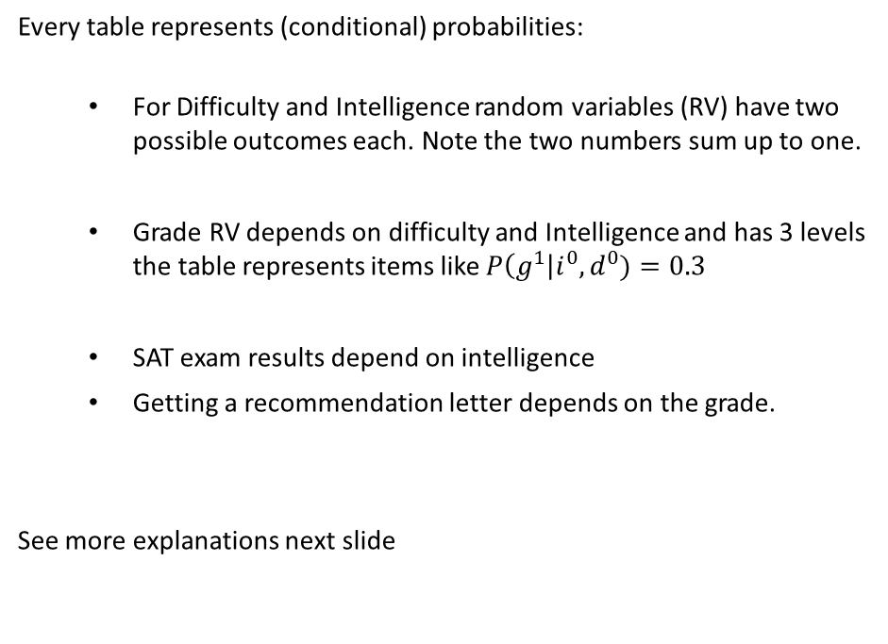
Efficient representation of joint probabilities (2/5)
Every table represents (conditional) probabilities:
  For Difficulty and Intelligence random variables (RV) have two possible outcomes each. Note the two numbers sum up to one.
  Grade RV depends on difficulty and Intelligence and has 3 levels the table represents items like $P\left(g^{1}\right|i^{0},d^{0})=0.3$
  SAT exam results depend on intelligence
  Getting a recommendation letter depends on the grade.
See more explanations next slide
Bayesian networks (ermongroup.github.io)

Slide 65
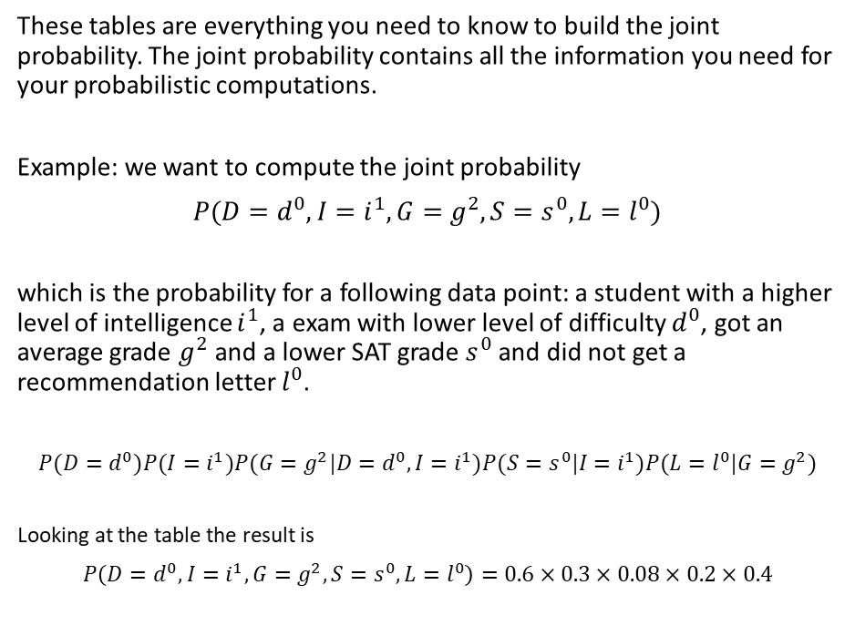
Efficient representation of joint probabilities (3/5)
These tables are everything you need to know to build the joint probability. The joint probability contains all the information you need for your probabilistic computations.
Example: we want to compute the joint probability
$$P(D=d^{0},I=i^{1},G=g^{2},S=s^{0},L=l^{0})$$
which is the probability for a following data point: a student with a higher level of intelligence $i^{1}$, a exam with lower level of difficulty $d^{0}$, got an average grade $g^{2}$ and a lower SAT grade $s^{0}$ and did not get a recommendation letter $l^{0}$.
$$P(D=d^{0})P(I=i^{1})P(G=g^{2}|D=d^{0},I=i^{1})P(S=s^{0}|I=i^{1})P(L=l^{0}|G=g^{2})$$
Looking at the table the result is
$$P\left(D=d^{0},I=i^{1},G=g^{2},S=s^{0},L=l^{0}\right)=0.6×0.3×0.08×0.2×0.4$$
Bayesian networks (ermongroup.github.io)

Slide 66
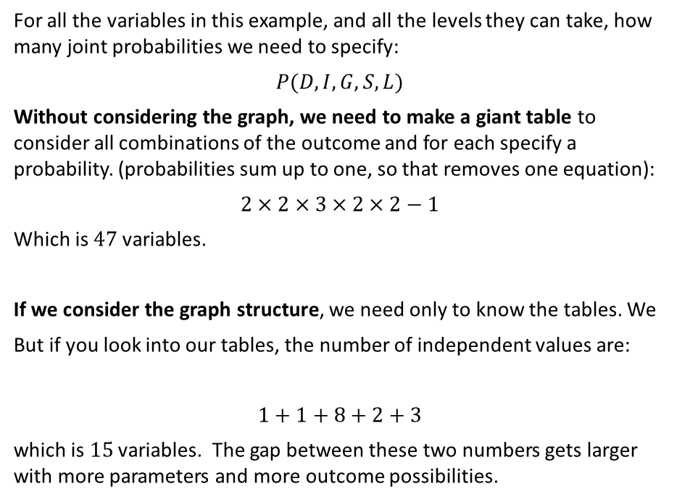
Efficient representation of joint probabilities (4/5)
For all the variables in this example, and all the levels they can take, how many joint probabilities we need to specify:
$$P(D,I,G,S,L)$$
Without considering the graph, we need to make a giant table to consider all combinations of the outcome and for each specify a probability. (probabilities sum up to one, so that removes one equation):
$$2×2×3×2×2−1$$
Which is $47$ variables.
If we consider the graph structure, we need only to know the tables. We
But if you look into our tables, the number of independent values are:
$$1+1+8+2+3$$
which is $15$ variables. The gap between these two numbers gets larger with more parameters and more outcome possibilities.
Bayesian networks (ermongroup.github.io)

Slide 67
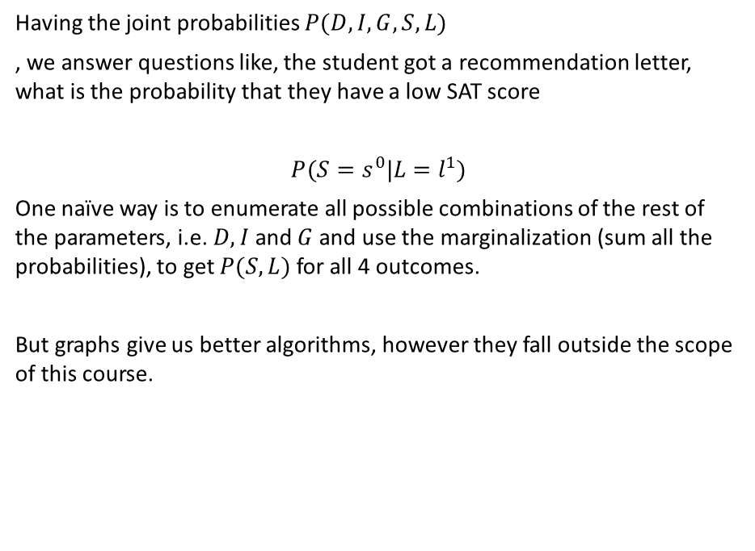
Efficient representation of joint probabilities (5/5)
Having the joint probabilities $P(D,I,G,S,L)$
, we answer questions like, the student got a recommendation letter, what is the probability that they have a low SAT score
$$P(S=s^{0}|L=l^{1})$$
One naïve way is to enumerate all possible combinations of the rest of the parameters, i.e. $D,I$ and $G$ and use the marginalization (sum all the probabilities), to get $P(S,L)$ for all 4 outcomes.
But graphs give us better algorithms, however they fall outside the scope of this course.
Bayesian networks (ermongroup.github.io)

Slide 68
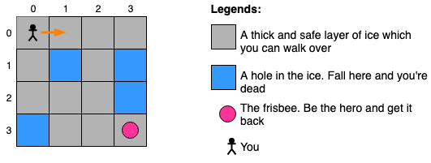


Example: Frozen Lake
When you make a move, you may slip, so there is uncertainty in your next position given your actions. There is also uncertainty in your actions.
Initial Position
Prev. position
Current position
Next position
Final Position
$$⋯$$
$$⋯$$
$$P\left(X_{1}=x_{1}\right)×P\left(X_{2}=x_{2} | X_{1}=x_{1}\right)×P\left(X_{3}=x_{3} | X_{2}=x_{2}\right)×⋯×P\left(X_{N}=x_{N} | X_{N−1}=x_{N−1}\right)$$

Slide 69
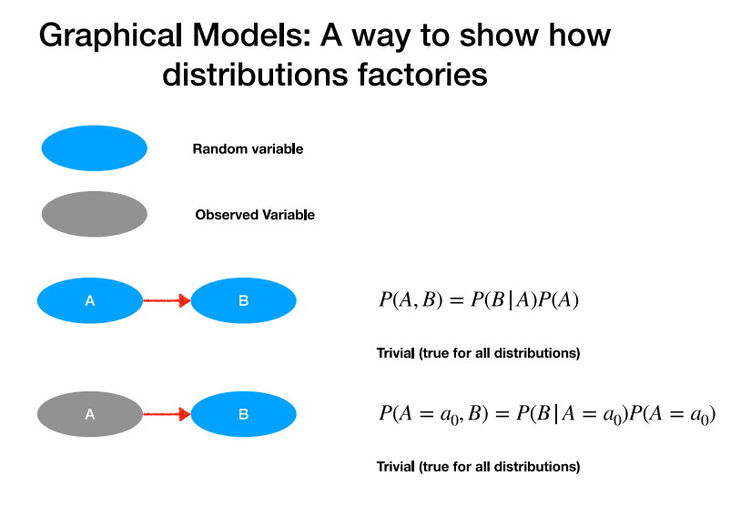
See Chapter 8 of Pattern Recognition and Machine Learning (microsoft.com)

Slide 70
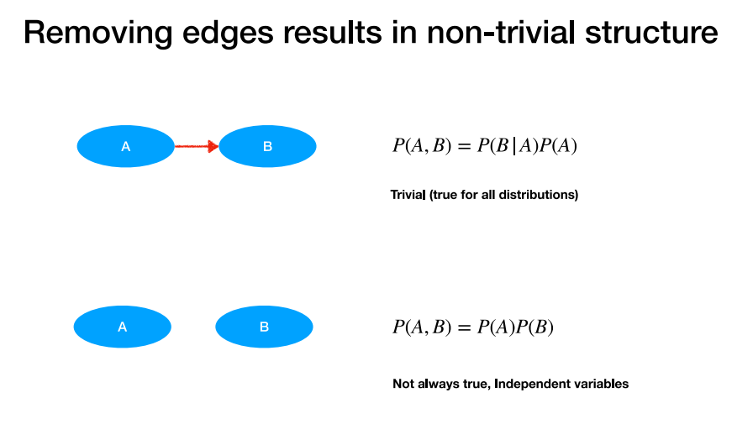

Slide 71
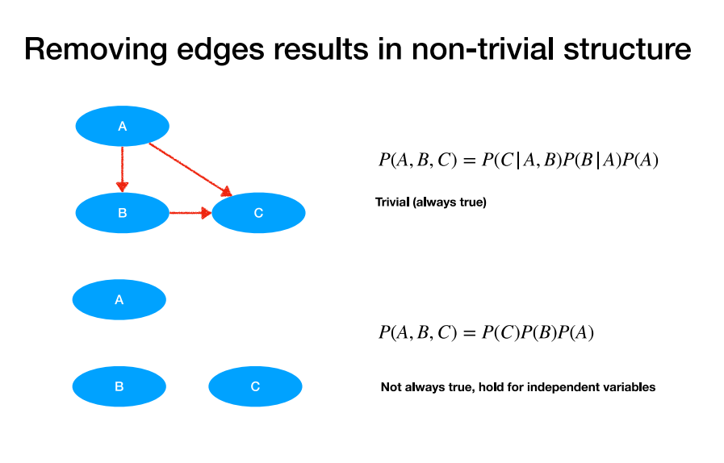

Slide 72
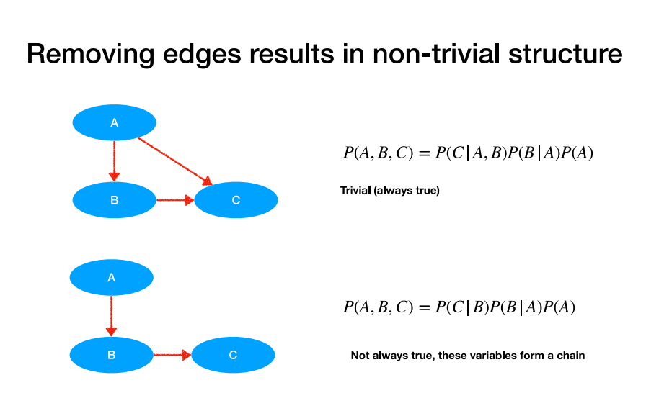
Notes:
Counting the number of numbers that has to be specified for the full table vs. factorized one

Slide 73
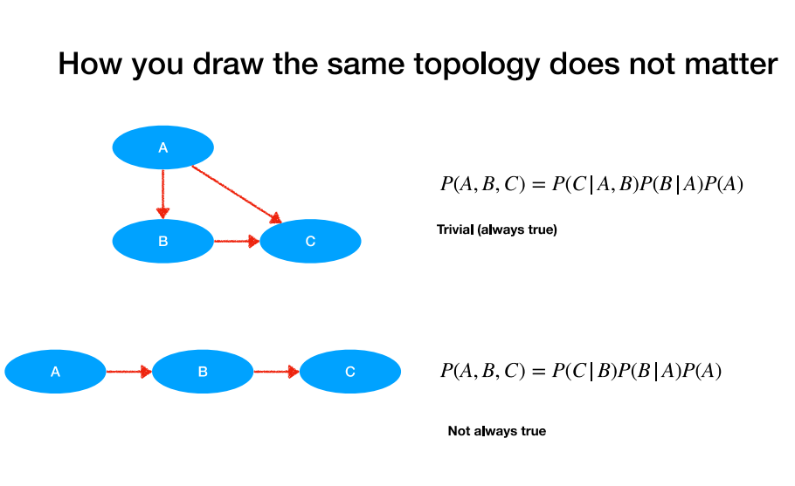

Slide 74
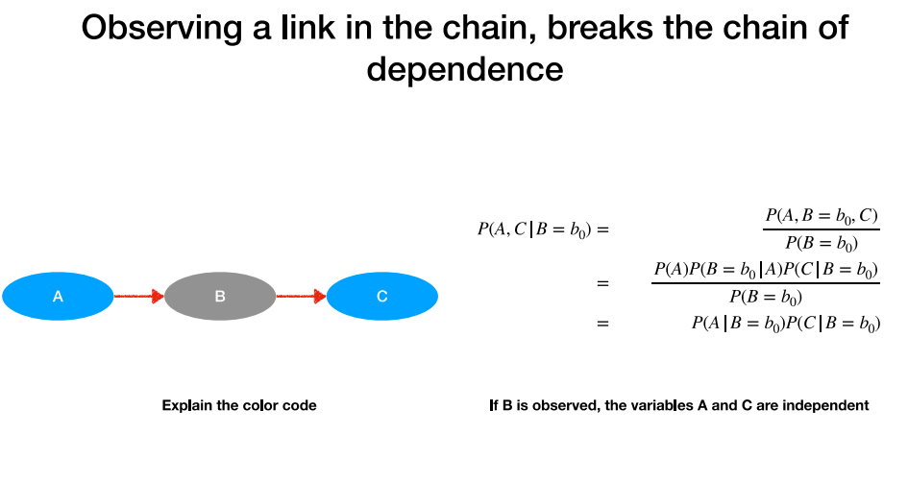
Prove how the third line is derived from the second line.

Slide 75
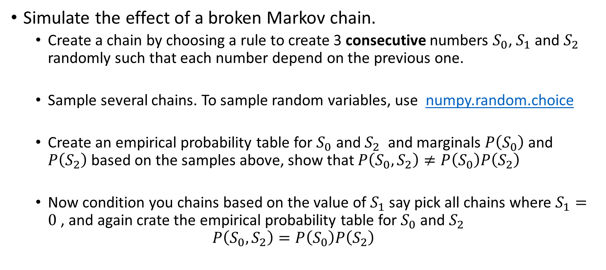
It is your turn
Simulate the effect of a broken Markov chain.
  Create a chain by choosing a rule to create 3 consecutive numbers $S_{0}$, $S_{1}$ and $S_{2}$ randomly such that each number depend on the previous one.
  Sample several chains. To sample random variables, use numpy.random.choice
  Create an empirical probability table for $S_{0}$ and $S_{2}$ and marginals $P\left(S_{0}\right)$and $P\left(S_{2}\right)$based on the samples above, show that $P\left(S_{0},S_{2}\right)≠P\left(S_{0}\right)P\left(S_{2}\right)$
  Now condition you chains based on the value of $S_{1}$ say pick all chains where $S_{1}=0$ , and again crate the empirical probability table for $S_{0}$ and $S_{2}$
  $$P\left(S_{0},S_{2}\right)=P\left(S_{0}\right)P\left(S_{2}\right)$$

Slide 76
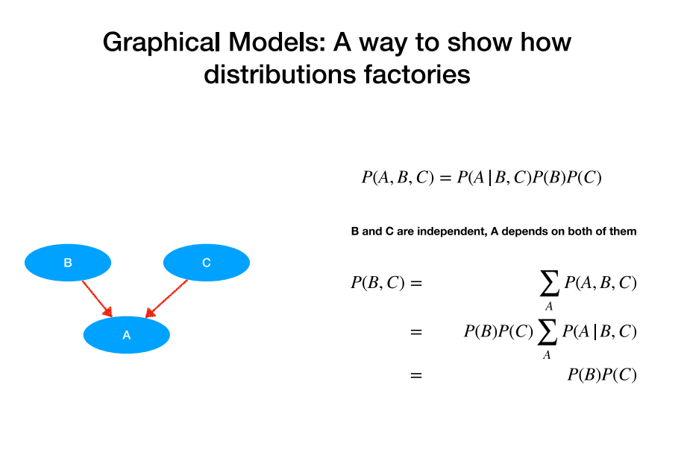

Slide 77
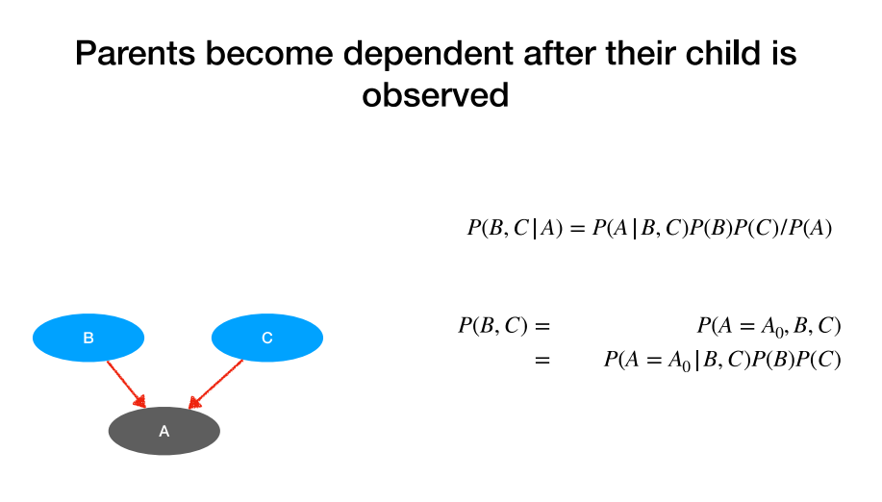

Slide 78
The Sprinkler and Rain are Causally independent. But observing that the grass is wet makes them statistically dependent.

Slide 79
It is your turn
Simulate the effect of dependent parent nodes after their child is observed.
Work in groups of two
To sample random variables use numpy.random.choice
https://numpy.org/doc/stable/reference/random/generated/numpy.random.choice.html

Slide 80
Simpson's Paradox

Slide 81
Simpson's Paradox
>
>
<
Chapter 2 Correlation and Simpson’s Paradox | Causal Inference and Its Applications in Online Industry (alexdeng.github.io)

Slide 82
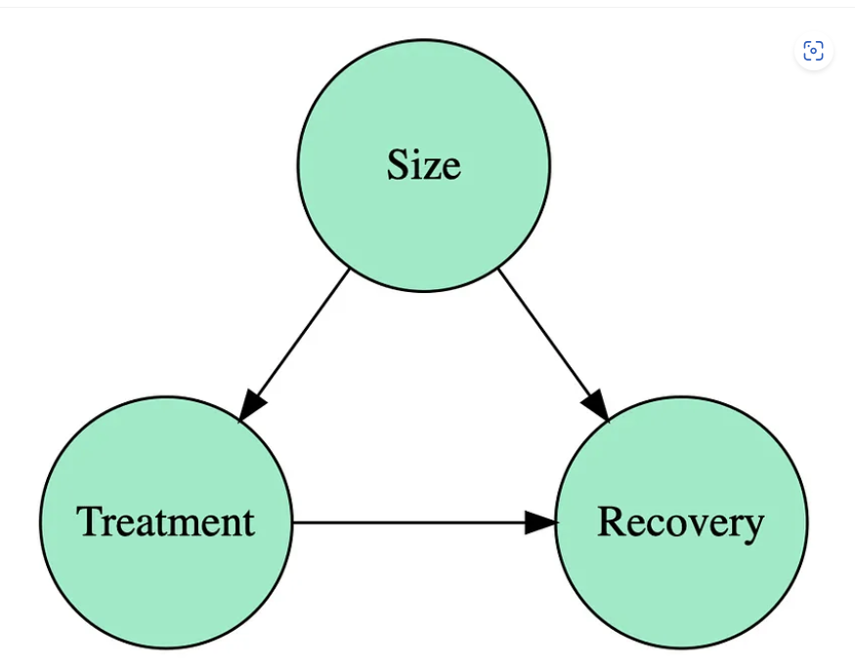
Simpson's Paradox
Solving Simpson’s Paradox. Understand a key toy example in causal… | by Aleix Ruiz de Villa | Towards Data Science
Notes:
Solving Simpson’s Paradox. Understand a key toy example in causal… | by Aleix Ruiz de Villa | Towards Data Science

Slide 83

Correlation Vs. Causation
Misinformation
Notes:
Correlation between covid vaccine coverage ( in subgroups) and covid death rate, which can be explained by for example age (also an example of Simpson's paradox).

Slide 84
A 2020 Washington Post article concluded that, “A review of spending on state and local police over the past 60 years…shows no correlation nationally between spending and crime rates.”
This correlation is misleading.
An important driver of police spending is the current level of crime, which creates a chicken and egg scenario.
Causal research has, in fact, shown that more police lead to a reduction in crime.
Notes:
Leaders: Stop Confusing Correlation with Causation (hbr.org)
randomized controlled trial
Higher sales in areas with more ads, but correlation due to pre-existing purchase intentions.

Slide 85
In 2013, eBay was spending roughly $50 million dollars per year advertising on search engines.
An analysis from consultants had shown that in areas where more advertisements were shown, sales were higher.
However, economists found that these ads were largely a waste.
The advertisements were targeting people who were already likely to shop on eBay.
The targeted customers’ pre-existing purchase intentions were responsible for both the advertisements being shown and the purchase decisions.
Notes:
Leaders: Stop Confusing Correlation with Causation (hbr.org)
randomized controlled trial
Higher sales in areas with more ads, but correlation due to pre-existing purchase intentions.

Slide 86
Confusing correlation with causation leads to mistakes and avoidable disasters, whether it’s an individual, a company, or a government that’s making the decision.
Leaders: Stop Confusing Correlation with Causation (hbr.org)

Slide 87


Simpson's Paradox

Slide 88



Simpson's Paradox
.
  Wisconsin ( ) vs. Texas ( ) education system

Slide 89
State
$$P\left(\text{Outcome}\text{,}\text{Education,}\text{B}\text{ackground,State}\right)$$
Socio-Economy
Education
Outcome

Slide 90
State
$$P\left(\text{Education,State, Outcome,background}\right)$$
Socio-Economy
Education
Outcome
$P\left(\text{State} \right)P\left(\text{background} | \text{State}\right)P\left(\text{Education} | \text{background,State}\right)$ $P\left(\text{Outcome} | \text{Education}\text{,}\text{background,State}\right)$

Slide 91


State
$$P\left(\text{Education} | \text{State, Outcome}\right)$$
Socio-Economy
Education
Outcome
  Wisconsin ( ) vs. Texas ( ) education system

Slide 92

State
$$P\left(\text{Education} | \text{State, Outcome,background}\right)$$
Socio-Economy
Education
Outcome

Slide 93
If you are worried that a correlation might not be causal, experiments can be a good starting point.
Companies such as Amazon and Booking.com put experiments at the heart of their decision-making process.
Notes:
Leaders: Stop Confusing Correlation with Causation (hbr.org)
a large-scale experiment that gave packages of advertisements to thousands of randomly selected businesses.

Slide 94
Appendix
Bayesian vs Frequentist

Slide 95
Treatment Effect
Suppose we want to see if drinking coffee can make you respond to a challenge in less than 2 minutes.
We measured 100 people, 50 of them got the coffee, and 50 of them not.
We then test who can solve the challenge in less than 2 minutes.
People who drink the coffee, 40 could pass.
People who did not drink the coffee, 30 could pass.
Is drinking coffee beneficial to clearing the challenge in less than 2 minutes?

Slide 96
Data
 | Passed | Failed | Total
Coffee | 40 | 10 | 50
No coffee | 30 | 20 | 50
Given that we observed 40/50 passing with coffee and 30/50 without coffee, what should we believe about the underlying pass rates?

Slide 97

Observed pass rates
Observed is not true value, it depends on the data, that is noisy.
$${\hat{p}}_{+}=P\left(\text{pass}∣\text{coffee}\right)≈\frac{40}{50}=0.80$$
and
$${\hat{p}}_{−}=P\left(\text{pass}∣\text{no coffee}\right)≈\frac{30}{50}=0.60.$$
You observe a difference of
$$0.80−0.60=0.20.$$
But this does not mean that the true difference in the population is exactly 20 percentage points. It could have been different numbers if we had a different sample.

Slide 98

We need a model to answer the question
Given that we observed 40/50 passing with coffee and 30/50 without coffee, what should we believe about the underlying pass rates?
Your observations can be modeled as:
$$X_{+}∼\text{Binomial}\left(50 , p_{+}\right)$$
and
$$X_{+}∼\text{Binomial}\left(50 , p_{+}\right)$$

Slide 99

We also need prior distributions
You then put priors on $p_{+}$and $p_{−}$.
For example:
$$p_{+}∼\text{Beta}\left(1 , 1\right)$$
$$p_{−}∼\text{Beta}\left(1 , 1\right)$$

Slide 100

After observing the data, Bayes' rule gives:
$$p_{+}∣\text{data}∼\text{Beta}\left(41 , 11\right)$$
and
$$p_{−}∣\text{data}∼\text{Beta}\left(31 , 21\right).$$
Now you have posterior distributions, rather than just point estimates. And this allows you to ask the question you actually care about:
$$P\left(p_{+}>p_{−}∣\text{data}\right)?$$
Given our data, what is the probability that coffee genuinely improves the probability of completing the challenge within two minutes?

Slide 101

Hypothesis testing
A frequentist might formulate:
$$H_{0}:p_{+}=p_{−}$$
Which is coffee has no effect
versus
$$H_{1}:p_{+}≠p_{−}.$$
Coffee has an effect
Then they ask: If coffee actually has no effect, how surprising would it be to observe a difference as large as 20 percentage points?

Slide 102

Frequentist hypothesis testing
We observed that 80% of the coffee group passed, compared with 60% of the no-coffee group. So our observed difference is:
$${\hat{p}}_{1}−{\hat{p}}_{0}=0.20.$$
But seeing a difference does not automatically mean that coffee caused it.
Even if coffee had no effect, the two samples could still have different pass rates simply because of random sampling.

Slide 103

Homework:
Our quantity of interest is not $p_{1}$or $p_{0}$individually. It is the difference:
$$\hat{Δ}={\hat{p}}_{1}−{\hat{p}}_{0}.$$
Show that:
$$SE⁡\left(\hat{Δ}\right)=\sqrt{\frac{p_{1}\left(1−p_{1}\right)}{n_{1}}+\frac{p_{0}\left(1−p_{0}\right)}{n_{0}}}$$

Slide 104
Appendix
Gaussian Distribution

Slide 105

Introductory Statistics (Shafer and Zhang) - Statistics LibreTexts

Slide 106



Catastrophes and Heavy Tail Distribution
More than 20 $σ$
Black Monday (1987) - Wikipedia

Slide 107



T-Distribution
Student's t-distribution - Wikipedia
Notes:
Think of Euler's number as a limit to see how this will converge to a gaussian when the degrees of freedom goes to infinityl

Slide 108


Small Note: Gamma Function
For complex z with positive real part
For integer n:
If this is confusing remember Gamma is the same as factorial when z is an integer.

Slide 109

For small sample size you often use t-distribution (The first 11 minutes)
Also watch Z-statistics or t-statistics: Z-statistics vs. T-statistics (video) | Khan Academy

